Slide 1
Stipulation Visit Webinar
January 9, 2020
Malina Monaco, Ph.D.
Vice President, CAEP

Slide 2
Stipulation Virtual Visit
Accreditation with Stipulation
2 year term
Followed by virtual visit where team reviews evidence submitted and makes recommendation about stipulation being met
1 stipulation (but meeting the standard)
2 person team (lead and reviewer)
If joint state, State people are included on correspondence as well as present on the virtual visit.

Slide 3
CAEP Process
Template opens in AIMS-18 months prior to visit semester(CAEP)
Virtual Site Visit date is selected and communicated with Alexis Neal (alexis.neal@caepnet.org)
Stipulation Documentation- Due to CAEP early in the semester (EPP)
Team is formed; reviews Documentation (CAEP, Team)
Team writes Formative Report- (Team)
Formative Report sent to CAEP case manager for review - Team will submit Formative to EPP after review. (CAEP, Team)
Virtual Site Visit - (EPP, Team)
Final Site Visit report to CAEP- Team submits within 7 days of Virtual Visit to CAEP (Team)
Final Virtual Visit report sent to EPP- Submitted within 14 days of Virtual Visit (Team Lead)
Accreditation Council- Meets in October (for past Spring visits) and April (for fall visits)

Slide 4
Who do I contact if I have questions?
Me! I am the case manager for stipulation visits.
Dr. Malina Monaco
Vice President for Accreditation
Malina.Monaco@caepnet.org

Slide 5
What do I address in my Stipulation Report?
You are ONLY responding to the stipulation(s) in your report.
Example: My EPP has a stipulation in Standard 3 for component 3.1 and several AFIs in other standards.
You only address the stipulation tagged to component 3.1. You do not address any other AFIs in other standards. You will be addressing those AFIs in your annual report each year.

Slide 6
What does it look like in AIMS?

Slide 7
How many reviewers are on my team?
There are 2 reviewers on a stipulation case. One member is the lead and one a site visitor. Stipulation reviewers are assigned in the same manner as regular site teams and follow the same process and protocol.

Slide 8
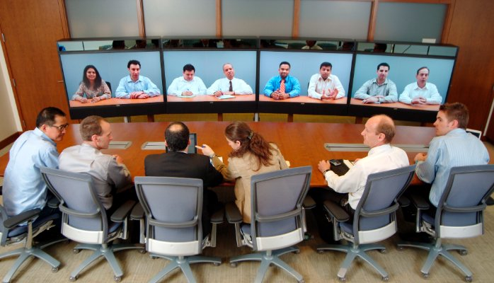
How does a virtual visit work?
Virtual site team will review your Stipulation report in AIMS.
Team writes a Formative report and shares with EPP.
Lead organizes Zoom meeting with CAEP or individually and shares call in information.
The team lead will communicate with the EPP about specific people that need to be on the virtual visit call for questions or verification.
During the scheduled time, the Team and EPP meet and review report, answer questions, interview key individuals or groups
Visits can last between 1-4 hours depending on how many stipulations and how many questions the team needs to be answered.

Slide 9
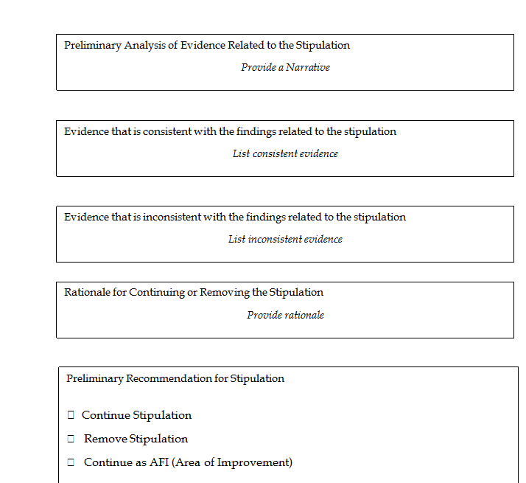
Formative Report Template

Slide 10
After the virtual site visit
The team writes a final report. The final report looks exactly like the Formative with additional sections for a list of who was on the call, any additional evidence provided, and preliminary recommendations.
Stipulation cases go to the Accreditation Council for Final decision.

Slide 11
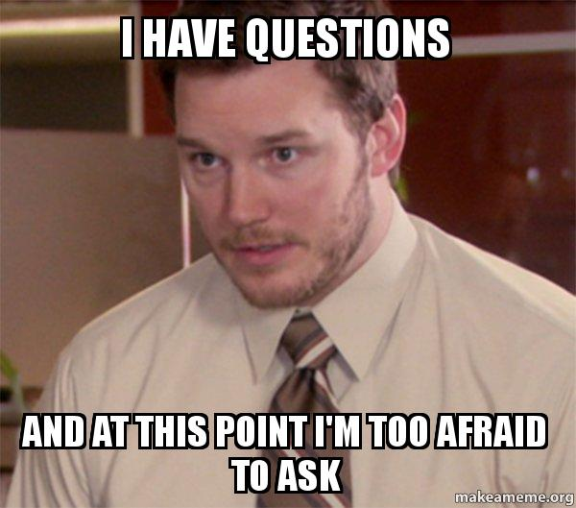
Questions?
Contact
Dr. Malina Monaco
Vice President
Malina.Monaco@caepnet.org

