Slide 1
Probation Visit Webinar
January 22, 2020
Malina Monaco
Vice President, CAEP

Slide 2
Probation Visit
Probation
Not meeting one standard
2 year term
Followed by physical site visit team to review evidence, make recommendation to Accreditation Council to determine standard is met.
Teams are comprised of 2 site visitors (lead and a reviewer).
If joint state, State people are included on correspondence as well as present on the visit.

Slide 3
CAEP Process
Template opens in AIMS-18 months prior to visit semester(CAEP)
Self Study Report (SSR)- Due to CAEP 9 months prior to visit (EPP)
Team is formed; reviews SSR (CAEP)
Formative Call scheduled- (Team)
Formative Feedback Report (FFR)- Team will submit FFR to EPP 5 months prior to visit. (Team)
SSR Addendum- EPP has 60 days to submit after FFR is received (EPP)
Site Visit Report (SVR)- Team submits within 30 days of Site Visit to CAEP (Team)
Factual correction- EPP submits any factual corrections within 7 days (EPP)
Final SVR- Submitted within 7 days of Site Visit (Team Lead)
Rejoinder- EPP has 30 days after receiving Final SVR to respond (EPP)
Rejoinder response- Team lead has 2 weeks after receipt of Rejoinder to respond (Team Lead)
Accreditation Council- Meets in October (for past Spring visits) and April (for fall visits)

Slide 4
Who do I contact if I have questions?
Me! I am the case manager for probation visits.
Dr. Malina Monaco
Vice President for Accreditation
Malina.Monaco@caepnet.org

Slide 5
What do I address in my Probation Self Study Report?
You are addressing ALL components of the unmet Standard
AND
Any Stipulations from any Met Standards
You do not address any AFIs in other MET standards. You will be addressing those AFIs in your annual report each year.

Slide 6
Example
My UNMET standard is Standard 5(Stipulations in 5.1 and 5.2) and I have a Stipulation in MET Standard 3 (3.1) as well as MET Standard 1 (1.5).
My Probation visit SSR will cover all components of Standard 5 (5.1, 5.2, 5.3, 5.4, and 5.5)
AND
Stipulation 3.1
AND
Stipulation 1.5

Slide 7
What does it look like in AIMS?
AIMS template looks exactly like a standard review.
Narrative
Evidence upload
Report templates(FFR, SVR, Addendum, Rejoinder)
The same preliminary items are requested (EPP Overview, Program characteristics, clinical educator qualifications, parity table). These can be cut and pasted from previous report(with updates as needed).
The Technology and Diversity Crosscuts do NOT have to be addressed

Slide 8
A note about the Site Visit Team
The Site Visit Team for Probation is NOT the same team that completed the previous review.
The team is not briefed about the previous review or have contact with previous team.
Teams do not have access to previous reports or evidences.
Teams are reviewing the probation narrative and evidence provided in AIMS independently of previous visit.

Slide 9
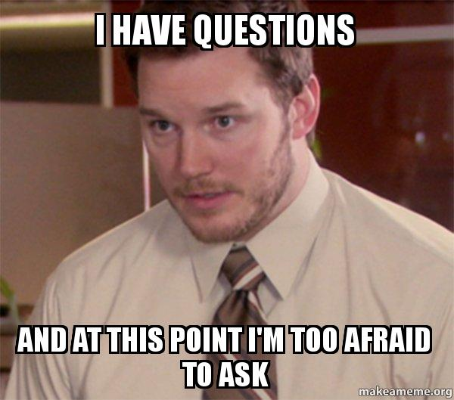
Questions?
Contact
Dr. Malina Monaco
Vice President
Malina.Monaco@caepnet.org

